Slide 1
Part – I : Analog Electronics
Chapter-2: BJT and its Applications
Reference:
Robert L. Boylestad, Louis Nashelsky, Electronic Devices & Circuit Theory, 11th Edition, PHI, 2012
MODULE 1: BJT Characteristics

Slide 2
BIPOLAR JUNCTION TRANSISTOR
Objectives
Discuss the operation of BJT.
Draw CB and CE configuration of transistor.
Explain input and output characteristics of CB and CE Configurations of transistor.
Derive expressions for current gains in transistor.

Slide 3
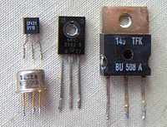
INTRODUCTION
BJT is 3 layer/terminal semiconductor device
Used in signal amplifiers, switches and oscillators
IMAGES OF TRANSISTOR
( Courtesy : wikipedia.org )
Notes:
Invented by a team of scientists at Bell laboratories during 1947-48.
Advantages of Transistors
Small size and light weight
Low power consumption and operating voltages
Low price

Slide 4
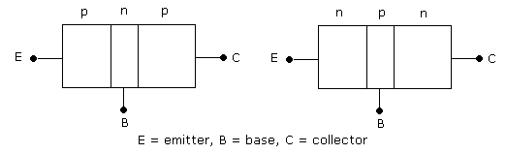
INTRODUCTION
Two types of transistors: NPN and PNP
The three layers of BJT are called Emitter, Base and Collector
Base is lightly doped. Emitter is heavily doped. Collector is moderately doped
BJT has two junctions – Emitter-Base (EB) Junction and Collector-Base (CB) Junction.
Notes:
The device is called “bipolar junction transistor” because current is due to motion of two types of charge carriers – free electrons & holes.

Slide 5
INTRODUCTION
Transistor symbols:
NPN Transistor PNP Transistor

Slide 6
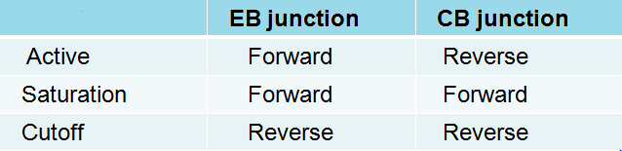
Transistor Operation
Depending upon the bias condition (forward or reverse) of each of the two junctions, different regions of operation for the BJT are obtained
Region
Active region- transistor operating as an amplifier (linear region)
Saturation & cutoff region- Switching applications, e.g. in logic circuits

Slide 7
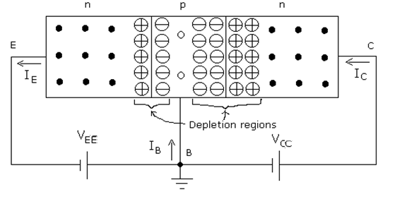

NPN TRANSISTOR OPERATION
Operation of NPN transistor and PNP is similar with roles of free electrons and holes interchanged
http://www.learnabout-electronics.org/bipolar_junction_transistors_05.php
Notes:
Operation of PNP is similar with roles of free electrons and holes interchanged.

Slide 8
CURRENTS IN TRANSISTOR
For both NPN and PNP transistor:
Collector current:
: Current due to injected charge carriers from
emitter
: Current due to thermally generated minority
carriers
Notes:
Value of α_{dc} < 1, since I_{E}>I_{C}

Slide 9
TRANSISTOR CONFIGURATIONS
BJT has three terminals
Accordingly three configurations exist:
Common Base (CB) configuration
Common Emitter (CE) configuration
Common Collector (CC) configuration
(The last one is not discussed in this course)

Slide 10
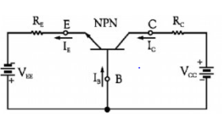
COMMON BASE CONFIGURATION
Base is common between input and output terminals

Slide 11
CURRENTS IN TRANSISTOR
For both NPN and PNP transistor:
Collector current:
: Current due to injected charge carriers from
emitter
: Current due to thermally generated minority
carriers
Neglecting reverse saturation current I_{CBO} ,
α_{dc} : Common-base dc current gain
Notes:
Value of α_{dc} < 1, since I_{E}>I_{C}

Slide 12
Numerical Problems
1. In a transistor, 99% of the carriers injected into the base cross over to the collector region. If collector current is 4mA and collector leakage current is 6 μA, Calculate emitter and base currents. (Ans: 4.034 mA, 34μA)
2. A transistor with α = 0.98 and I_{CBO} = 5 µA has I_{B} = 100 µA. Find I_{C} and I_{E}. (Ans: 5.15 mA, 5.25 mA)

Slide 13
CB CONFIGURATION INPUT CHARACTERISTICS
CB Input characteristics
A plot of input current(I_{E}) versus input voltage (V_{BE} ) for various values of output voltage (V_{CB})

Slide 14
Base Width modulation
As the reverse bias voltage V_{CB} is increased, the depletion region width at the C-B junction increases and base width decreases. Hence number of electron-hole combination at the base decreases. So base current reduces. Emitter current increases due to increase in concentration gradient (because of reduced effective base width).
This phenomenon is also called as the Early effect

Slide 15
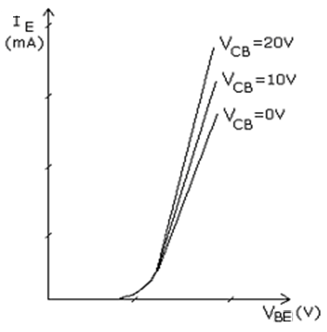
CB CONFIGURATION INPUT CHARACTERISTICS
CB Input characteristics
A plot of I_{E} versus V_{BE} for various values of V_{CB.}

Slide 16
CB CONFIGURATION OUTPUT CHARACTERISTICS
A plot of output current I_{C} versus output voltage V_{CB} for various values of input current I_{E} .
Notes:
Active region: E-B junction is forward biased and C-B junction is reverse biased.
Saturation region: E-B junction forward biased and C-B junction is forward biased.
Cut-off region: E-B junction is reverse biased and C-B junction is reverse biased.

Slide 17
CB CONFIGURATION OUTPUT CHARACTERISTICS
A plot of I_{C} versus V_{CB} for various values of I_{E} .
Divided into three regions:
Active Region
Saturation Region
Cutoff Region
Notes:
Active region: E-B junction is forward biased and C-B junction is reverse biased.
Saturation region: E-B junction forward biased and C-B junction is forward biased.
Cut-off region: E-B junction is reverse biased and C-B junction is reverse biased.

Slide 18
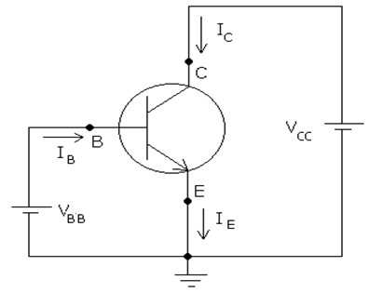
COMMON EMITTER CONFIGURATION
Emitter is common between input and output terminals

Slide 19
CURRENTS IN TRANSISTOR

Slide 20
CURRENTS IN TRANSISTOR
β_{dc} : Common emitter dc current gain
Reverse saturation current in CE configuration
Note I_{CEO} >> I_{CBO}
Notes:
Β>1, since I_{B} < I_{C}

Slide 21
Relation between alpha and beta

Slide 22
CE CONFIGURATION INPUT CHARACTERISTICS
Plot of I_{B} versus V_{BE} for various values of V_{CE}

Slide 23
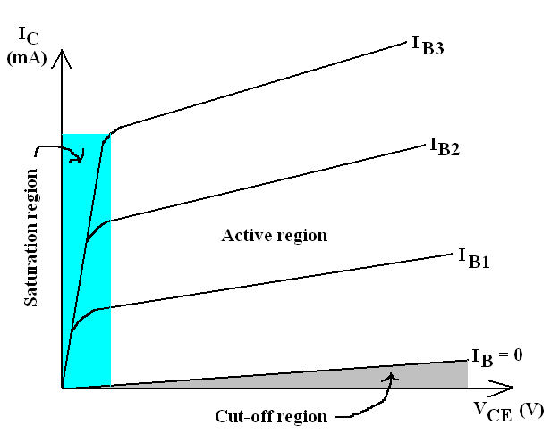
CE CONFIGURATION OUTPUT CHARACTERISTICS
A plot of I_{C} versus V_{CE} for various values of I_{B} .
Divided into three regions:
Active Region
Saturation Region
Cutoff Region

Slide 24
Exercise Problems
An NPN transistor has collector current 4mA and base current 10 μA. Calculate the alpha and beta values of the transistor, neglecting the reverse saturation current I_{CBO.} (Ans: 0.9975, 400)
2. In a transistor circuit, when the base current is increased from 0.32 mA to 0.48 mA, the emitter current increases from 15 mA to 20 mA. Find α_{ac} and β_{ac} values.
(Ans: 0.968, 30.25)
3. A Ge Transistor has collector current of 51 mA when the base current is 0.4 mA. If β = 125, then what is its collector cutoff current I_{CEO}?
(Ans: 1 mA)
4. The reverse leakage current of the transistor, when connected in common base mode is 0.1 μA, while it is 16 μA when the same transistor is connected in common emitter mode. Find α_{ac} and β_{ac}
(Ans: 0.993, 159)

Slide 25
Summary
In this module we have learnt:
The operation of a transistor and the relevant current components.
To plot the input and output characteristics of CB and CE Configuration transistor.
To find current gains in different configurations of transistor.

Slide 26
Part – I : Analog Electronics
Chapter-2: BJT and its Applications
Module 2: Transistor Biasing
Reference:
Robert L. Boylestad, Louis Nashelsky, Electronic Devices & Circuit Theory, 11th Edition, PHI, 2012

Slide 27

Module 2: Transistor Biasing
Objectives
Discuss the concept of biasing of the transistor.
Analyse the fixed and self bias circuits.
Identify the circuit parameters that effect Q point.
2
Department of Electronics and Communication Engineering, MIT, Manipal

Slide 28
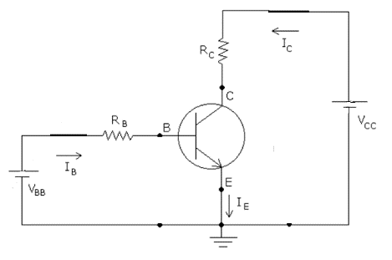
Biasing
Applying external dc voltages to ensure that transistor operates in the desired region.
Transistor circuit in CE Configuration
Applying KVL collector loop
Coordinates of load line
V_{CE} =V_{CC} ; I_{C} = 0 mA
V_{CE} =0 ; I_{C} = V_{CC}/R_{C}

Slide 29
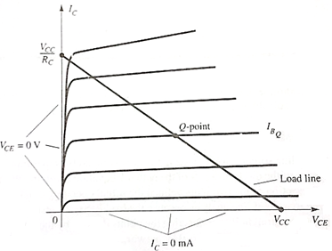
Load line and Operating point
Notes:
Operating Point: Intersection of load line with the base current results in operating point or Q point.

Slide 30
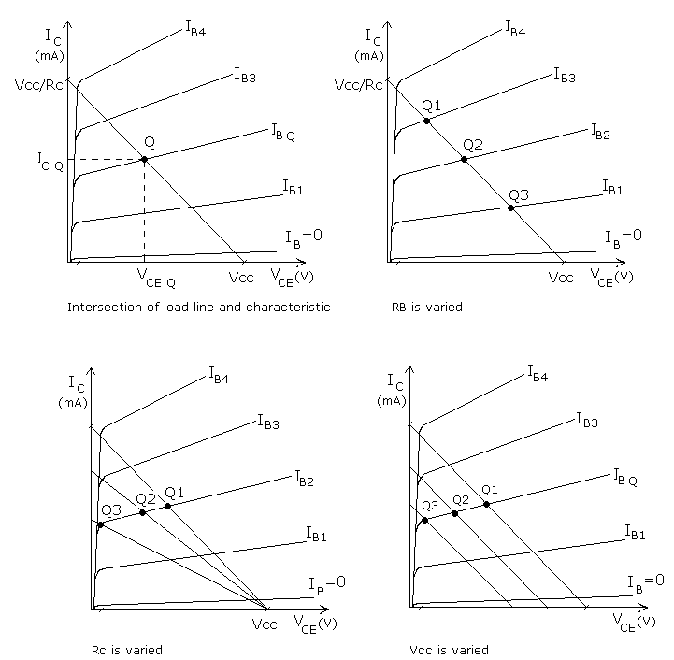
Load line and Operating point
Variation in load
line with circuit
parameters V_{CC},
R_{C} and R_{B}

Slide 31
Load line and Operating point
With reference to the graphs, with everything else held constant
If R_{B} is increased, transistor goes towards cut-off and if R_{B} is decreased, transistor goes towards saturation
If R_{C} is increased, transistor goes towards saturation and if R_{C} is decreased, transistor goes towards active region
If V_{CC} is increased, transistor goes towards active region and if V_{CC} is decreased, transistor goes towards saturation

Slide 32
Types of Biasing
Two types
Fixed bias
Voltage divider bias (self bias)

Slide 33
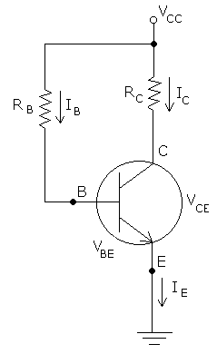
Transistor biasing
Fixed bias
2
Department of Electronics and Communication Engineering, MIT, Manipal
Notes:
The value of I_{B} is “fixed” by choosing proper value for R_{B.}

Slide 34
Exercise Problems
For a fixed bias circuit using Si transistor has R_{B} = 500 kΩ , R_{C} = 2 kΩ , V_{CC} = 15V, β = 70. Find the collector current I_{C ,} V_{CE} (Ans: 2.002mA, 10.996V)
2. A Si transistor is biased for a constant base current. If β = 80, V_{CEQ} = 8 V, R_{C} = 3 kΩ and V_{CC} = 15 V, find I_{CQ} and the value of R_{B} required. ( Ans: 2.33mA, 493KΩ)
3. Repeat the above problem , if the transistor is a Germanium device. ( Ans: 2.33mA, 507KΩ)
2
Department of Electronics and Communication Engineering, MIT, Manipal

Slide 35
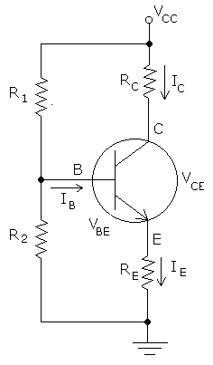
Transistor Biasing
2. Voltage divider bias (self bias)
2
Department of Electronics and Communication Engineering, MIT, Manipal
Notes:
--Voltage-divider resistors R₁ & R₂ replace R_{B.} of fixed bias.

Slide 36
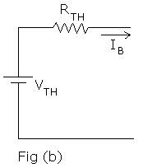
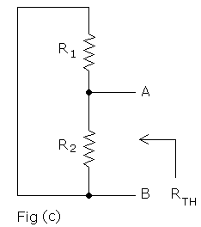
Transistor Biasing
2. Voltage divider bias (self bias)
2
Department of Electronics and Communication Engineering, MIT, Manipal
Notes:
--Voltage-divider resistors R₁ & R₂ replace R_{B.} of fixed bias.

Slide 37
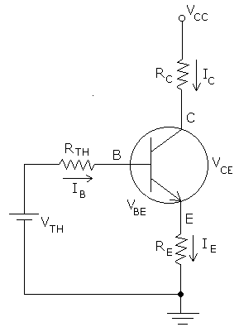
Transistor Biasing
Equivalent circuit :
link\self bias.docx
2
Department of Electronics and Communication Engineering, MIT, Manipal
Notes:
Since I_{C} is almost independent of β, Q-point is stable

Slide 38
Exercise Problems
For a self-bias circuit, the transistor is a Si device, R_{E} = 200 Ω, R₁ = 10R₂ = 10 kΩ, R_{C} = 2 kΩ, β = 100 and V_{CC} = 15 V. Determine the values of I_{CQ} and V_{CEQ}.
( Ans: 3.13mA, 8.11V)
For a voltage divider bias circuit, the transistor is a Si device, R_{E} = 400Ω, R₁ = 56 kΩ, R₂ = 12.2 kΩ, R_{C} = 2 kΩ, β = 150 and V_{CC} = 10 V. Determine the Q point. Also find V_{E}, V_{B,} V_{C}
(Ans: 2.32mA, 4.426V)
For the voltage divider bias find I_{C},V_{E}, V_{B} and R₁ . Given V_{CC} = 18 V, V_{C} =12V, R₂ = 5.6 kΩ, R_{C} = 4.7kΩ and R_{E} =1.2 kΩ. Assume Si transistor with β = 75
For a self-bias circuit using silicon transistor, R_{E} = 300 Ω, R_{C} =500 Ω,
V_{CC} = 15 V, β = 100 and β R_{E} = 10R₂. Find the values of R₁ and R₂ to get
V_{CEQ} = V_{CC} / 2.
(Ans: 9.03KΩ)
2
Department of Electronics and Communication Engineering, MIT, Manipal

Slide 39
For a self-bias circuit, the transistor is a Si device, R_{E} = 200 Ω, R₁ = 10R₂ = 10 kΩ, R_{C} = 2 kΩ, β = 100 and V_{CC} = 15 V. Determine the values of I_{CQ} and V_{CEQ}.
( Ans: 3.13mA, 8.11V)

Slide 40
For a voltage divider bias circuit, the transistor is a Si device, R_{E} = 400Ω, R₁ = 56 kΩ, R₂ = 12.2 kΩ, R_{C} = 2 kΩ, β = 150 and V_{CC} = 10 V. Determine the Q point. Also find V_{E}, V_{B,} V_{C}
(Ans: 2.32mA, 4.426V)

Slide 41
For the voltage divider bias find I_{C},V_{E}, V_{B} and R₁ . Given V_{CC} = 18 V, V_{C} =12V, R₂ = 5.6 kΩ, R_{C} = 4.7kΩ and R_{E} =1.2 kΩ. Assume Si transistor with β = 75

Slide 42
For a self-bias circuit using silicon transistor, R_{E} = 300 Ω, R_{C} =500 Ω, V_{CC} = 15 V, β = 100 and β R_{E} = 10R₂. Find the values of R₁ and R₂ to get V_{CEQ} = V_{CC} / 2. (Ans: 9.03KΩ)

Slide 43
Summary
In this module we have learnt:
Importance of biasing in transistors
Concept of load line, operating point and their significance
Operating point dependent on the circuit parameters such as supply voltage and resistor values as well as operating temperatures.
To analyse fixed bias circuit to obtain the operating point and plot the load line.
Finding the equivalent circuit for self bias circuit and analyse it to obtain the Q point.

Slide 44
Part – I : Analog Electronics
Chapter-2: BJT and its Applications
Module 3: Transistor as an Amplifier
Reference:
Robert L. Boylestad, Louis Nashelsky, Electronic Devices & Circuit Theory, 11th Edition, PHI, 2012

Slide 45
Module-3 : Transistor as an Amplifier
Objectives
Discuss the basic concepts of an amplifier.
Analyze the RC coupled amplifier circuit with and without feedback.
Plot the frequency response of an amplifier and define the bandwidth.

Slide 46
Transistor Amplifier
Base current is the input
Collector current is the output
BJT amplifies the input current as long as it is biased in active region

Slide 47
Transistor Amplifier
When Vin = 0 we get operating point IBQ, ICQ, VCEQ
As Vin varies iB, ic and VCE varies around IBQ, ICQ, VCEQ

Slide 48
Transistor Amplifier

Slide 49

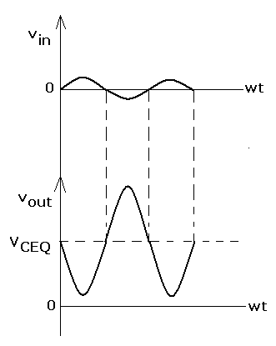
Output voltage will be amplified version of $v_{in}$ but 180 degree out of phase w.r.t input
$V_{out}$ = $v_{CE}$ = $V_{CC}$- $i_{C}R_{C}$
=$V_{CC}$-$\left(i_{c}\text{+}I_{C}\right)R_{C}$
When $v_{in}$=0, $V_{out}$=$V_{CEQ}$

Slide 50
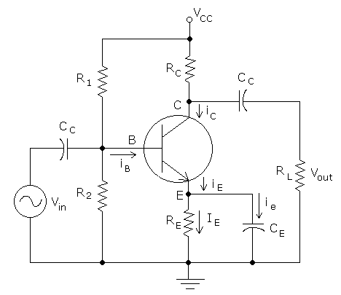
CE RC Coupled Amplifier
2
Department of Electronics and Communication Engineering, MIT, Manipal
Notes:
C_{C} is coupling capacitor (to block dc ), C_{E} is emitter bypass capacitor (to prevent feedback).
R₁ ,R_{2,} ,R_{E} ,R_{C} are used for biasing

Slide 51
RC Coupled Amplifier
R1, R2, Rc, RE used for biasing to select Q point
Capacitors are used for blocking DC
Cc coupling capacitor and CE emitter bypass capacitor

Slide 52
RC Coupled Amplifier-Feedback
CE is present, No feedback
Large gain
Without CE, there is feedback
Gain reduces

Slide 53
Frequency Response of RC coupled Amplifier
Frequency versus gain plot

Slide 54
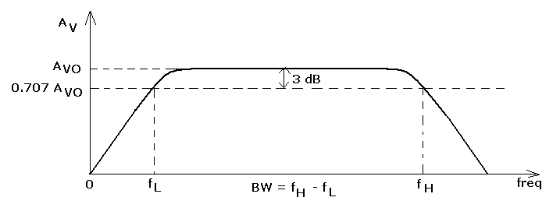
Frequency Response
Frequency response of amplifier:
Low frequency, mid-band frequency and high frequency region
Bandwidth of amplifier : f_{H} - f_{L}.
2
Department of Electronics and Communication Engineering, MIT, Manipal
Notes:
Frequency response is a plot of gain versus frequency.
3 dB frequency: The frequency were gain reduced by 3 dB of its maximum value.

Slide 55
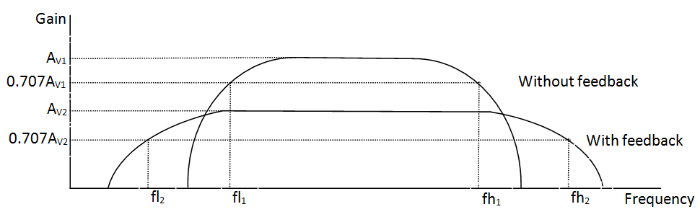
Transistor Amplifier
Frequency response of amplifier:
Bandwidth of amplifier : f_{H} - f_{L}.
link\freqency response.docx
2
Department of Electronics and Communication Engineering, MIT, Manipal
Notes:
Frequency response is a plot of gain versus frequency.
3 dB frequency: The frequency were gain reduced by 3 dB of its maximum value.

Slide 56
Transistor Amplifier
Analysis of frequency response curve
At very low frequencies, reactance of coupling capacitors is high, hence there is loss of signal voltage across capacitors, resulting in reduced gain
Also at low frequencies, emitter bypass capacitor does not fully bypass the ac emitter current, hence more ac voltage drop develops across R_{E}, resulting in reduced gain
At very high frequencies, reactance of junction capacitances will become low. This offers low reactance path for signal to ground, thus reducing voltage gain.
At mid frequencies, gain is maximum and constant

Slide 57
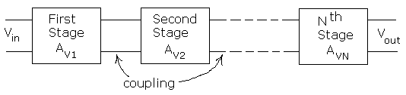
Multistage Amplifier
Gain in decibels,
(A_{V})_{dB} = 20 log₁₀ | A_{V} |
Multistage transistor
2
Department of Electronics and Communication Engineering, MIT, Manipal
Notes:
Up to gain of 100 (i.e., 40 dB) is obtained with single transistor.
For larger gain, more amplifier stages are to be cascaded.

Slide 58
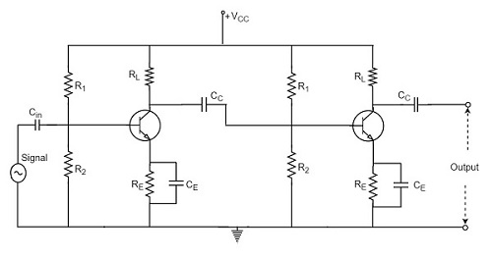
2 Stage RC Coupled Amplifier

Slide 59
Q1.An amplifier is known to have a power gain of 40dB. If the output power is 4W, determine the input power. (Ans:0.4mW)

Slide 60
Q2.What output power is obtained from an amplifier whose power gain is 55 dB, when the input power is 1 mW? (Ans: 316.23W)

Slide 61
Q3. In a three-stage amplifier, the voltage gain of first stage is 40 dB, gain of second stage is 200 and that of third stage is 0 dB. Find the overall gain of the amplifier.(Ans: 86.02dB)

Slide 62
4. A three-stage amplifier circuit has first stage gain of 45 dB, second stage gain of 50 dB and third stage gain of –5 dB. What is the overall gain? If input to the first stage is 0.1mV, what is the output of final stage? (Ans: 3.162V)

Slide 63
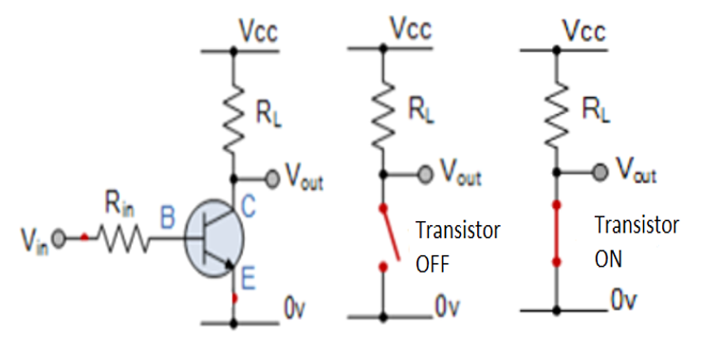
Transistor as a switch

Slide 64
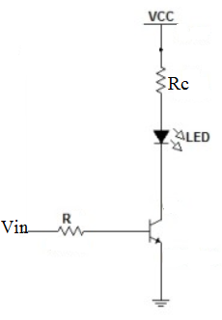
Transistor as LED driver
2
Department of Electronics and Communication Engineering, MIT, Manipal
Notes:
When Input voltage V_{IN} is ZERO , transistor is OFF(cut-off region), LED is OFF..
When Input voltage V_{IN} is HIGH , transistor is ON (saturation region) , LED turns ON.

Slide 65
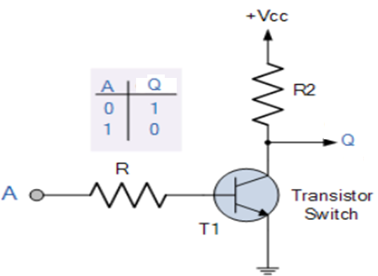
Transistor as Inverter
Notes:
When A = 0 , transistor is OFF(cut-off region), Output Q = 1.
When A = 1, transistor is ON (saturation region) , Output Q = 0.

